Slide 1
House Pricing Analysis
Ibrahim Hafiz

Slide 2
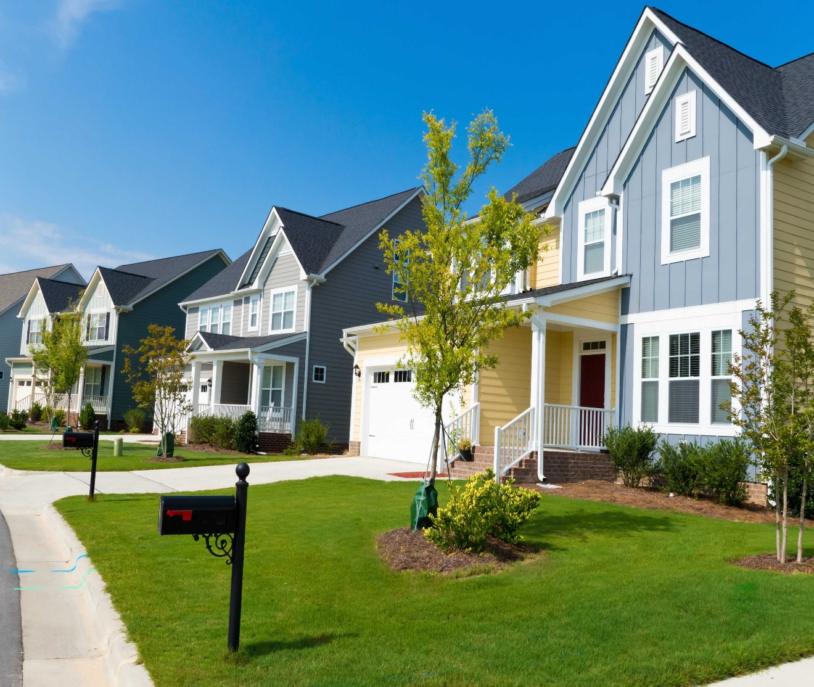
Table of content
- Business Understanding
- Data Understanding & Methods
- Data Preparation
- Results
- Assumption checks
- Accuracy
- Conclusion

Slide 3
Business Understanding
Our stakeholder is a real estate company that is looking to expand its market to King County. They need to be provided with a reliable prediction model about how new home renovations might increase the estimated value of homes in the area, and by what amount.
Using the data we created a linear regression model to come up with a conclusive analysis.

Slide 4
Data Understanding and Methods Used
We checked for multicollinearity and removed all the data that had correlated predictors. We removed the bathroom and sqrft_basement because they had a high correlation to one another.
We normalized continuous data for our linear model.
The data we had was positively skewed which means we had to perform a log transformation in order to ensure it had a normal distribution.

Slide 5
Data preparation
We will start by removing the rows with the null values in yr_renovated because we do not know whether they have been renovated or not. We will also remove the basement values which are not numbers.
This will allow us to have plenty of data to use after removing them. Finally we will remove the outliers in the bedroom as well.
We will drop the house with 33 bedrooms because it is the only outlier we will do this when cleaning the data.

Slide 6
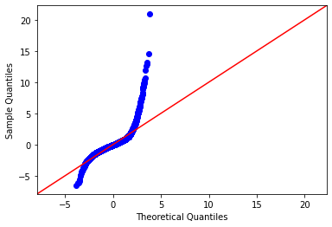
Results in Model 1 and Model 2
- R-Squared value of 0.62 which is resonable, which allows us to explain 62.1% of variations of our model.
- Skewness & Kurtosis values high
std_above had p-values which were greater than 0.05 which we will remove in our next model.
We will run a log transformation on the prices as well on the next model.

Slide 7
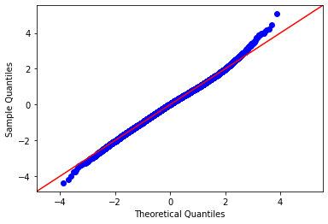
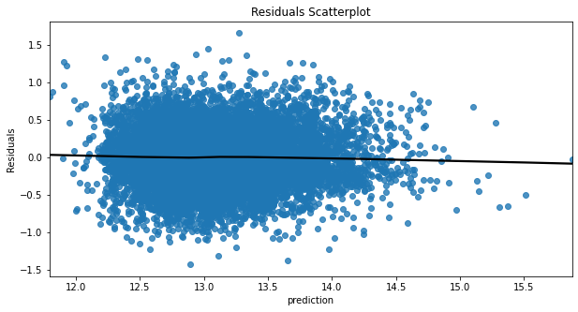
Model 3
- Log transformation on price improved in the distribution
- We also checked for Homoscedasticity, this will help us know that the error is constant along the values of our dependent variable.
- R-Squared value increased. 63.8% of the variance is explained by the model.
model.

Slide 8
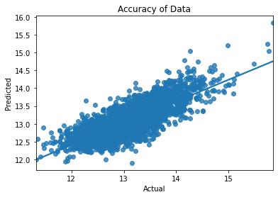
Accuracy of the Model
- Accuracy of the model is
61.6%
- There is a good correlation
between the actual results and
our predicted results.
-With training and testing being
similar we can expect the model to
perform similarly.

Slide 9
Conclusion
-With our final model our regression results indicate that the R^2 value is at 0.616 meaning it is 61.16% of the variance that is explained by our model.
- The Living area has strongest relationship with prices because people spend time inside the house and having a large living area generally means that more rooms, making it more appealing to potential buyers.
-This will give our stakeholder a grasp of the type of houses available at King County and the specification of what makes the value of a house appeciate in value or sell for.

